Slide 1
The wonders of nature

Slide 2
PRESENTED BY
HADIA ISLAM
BATCH NO: 41
ROLL NO:01-041-20

Slide 3
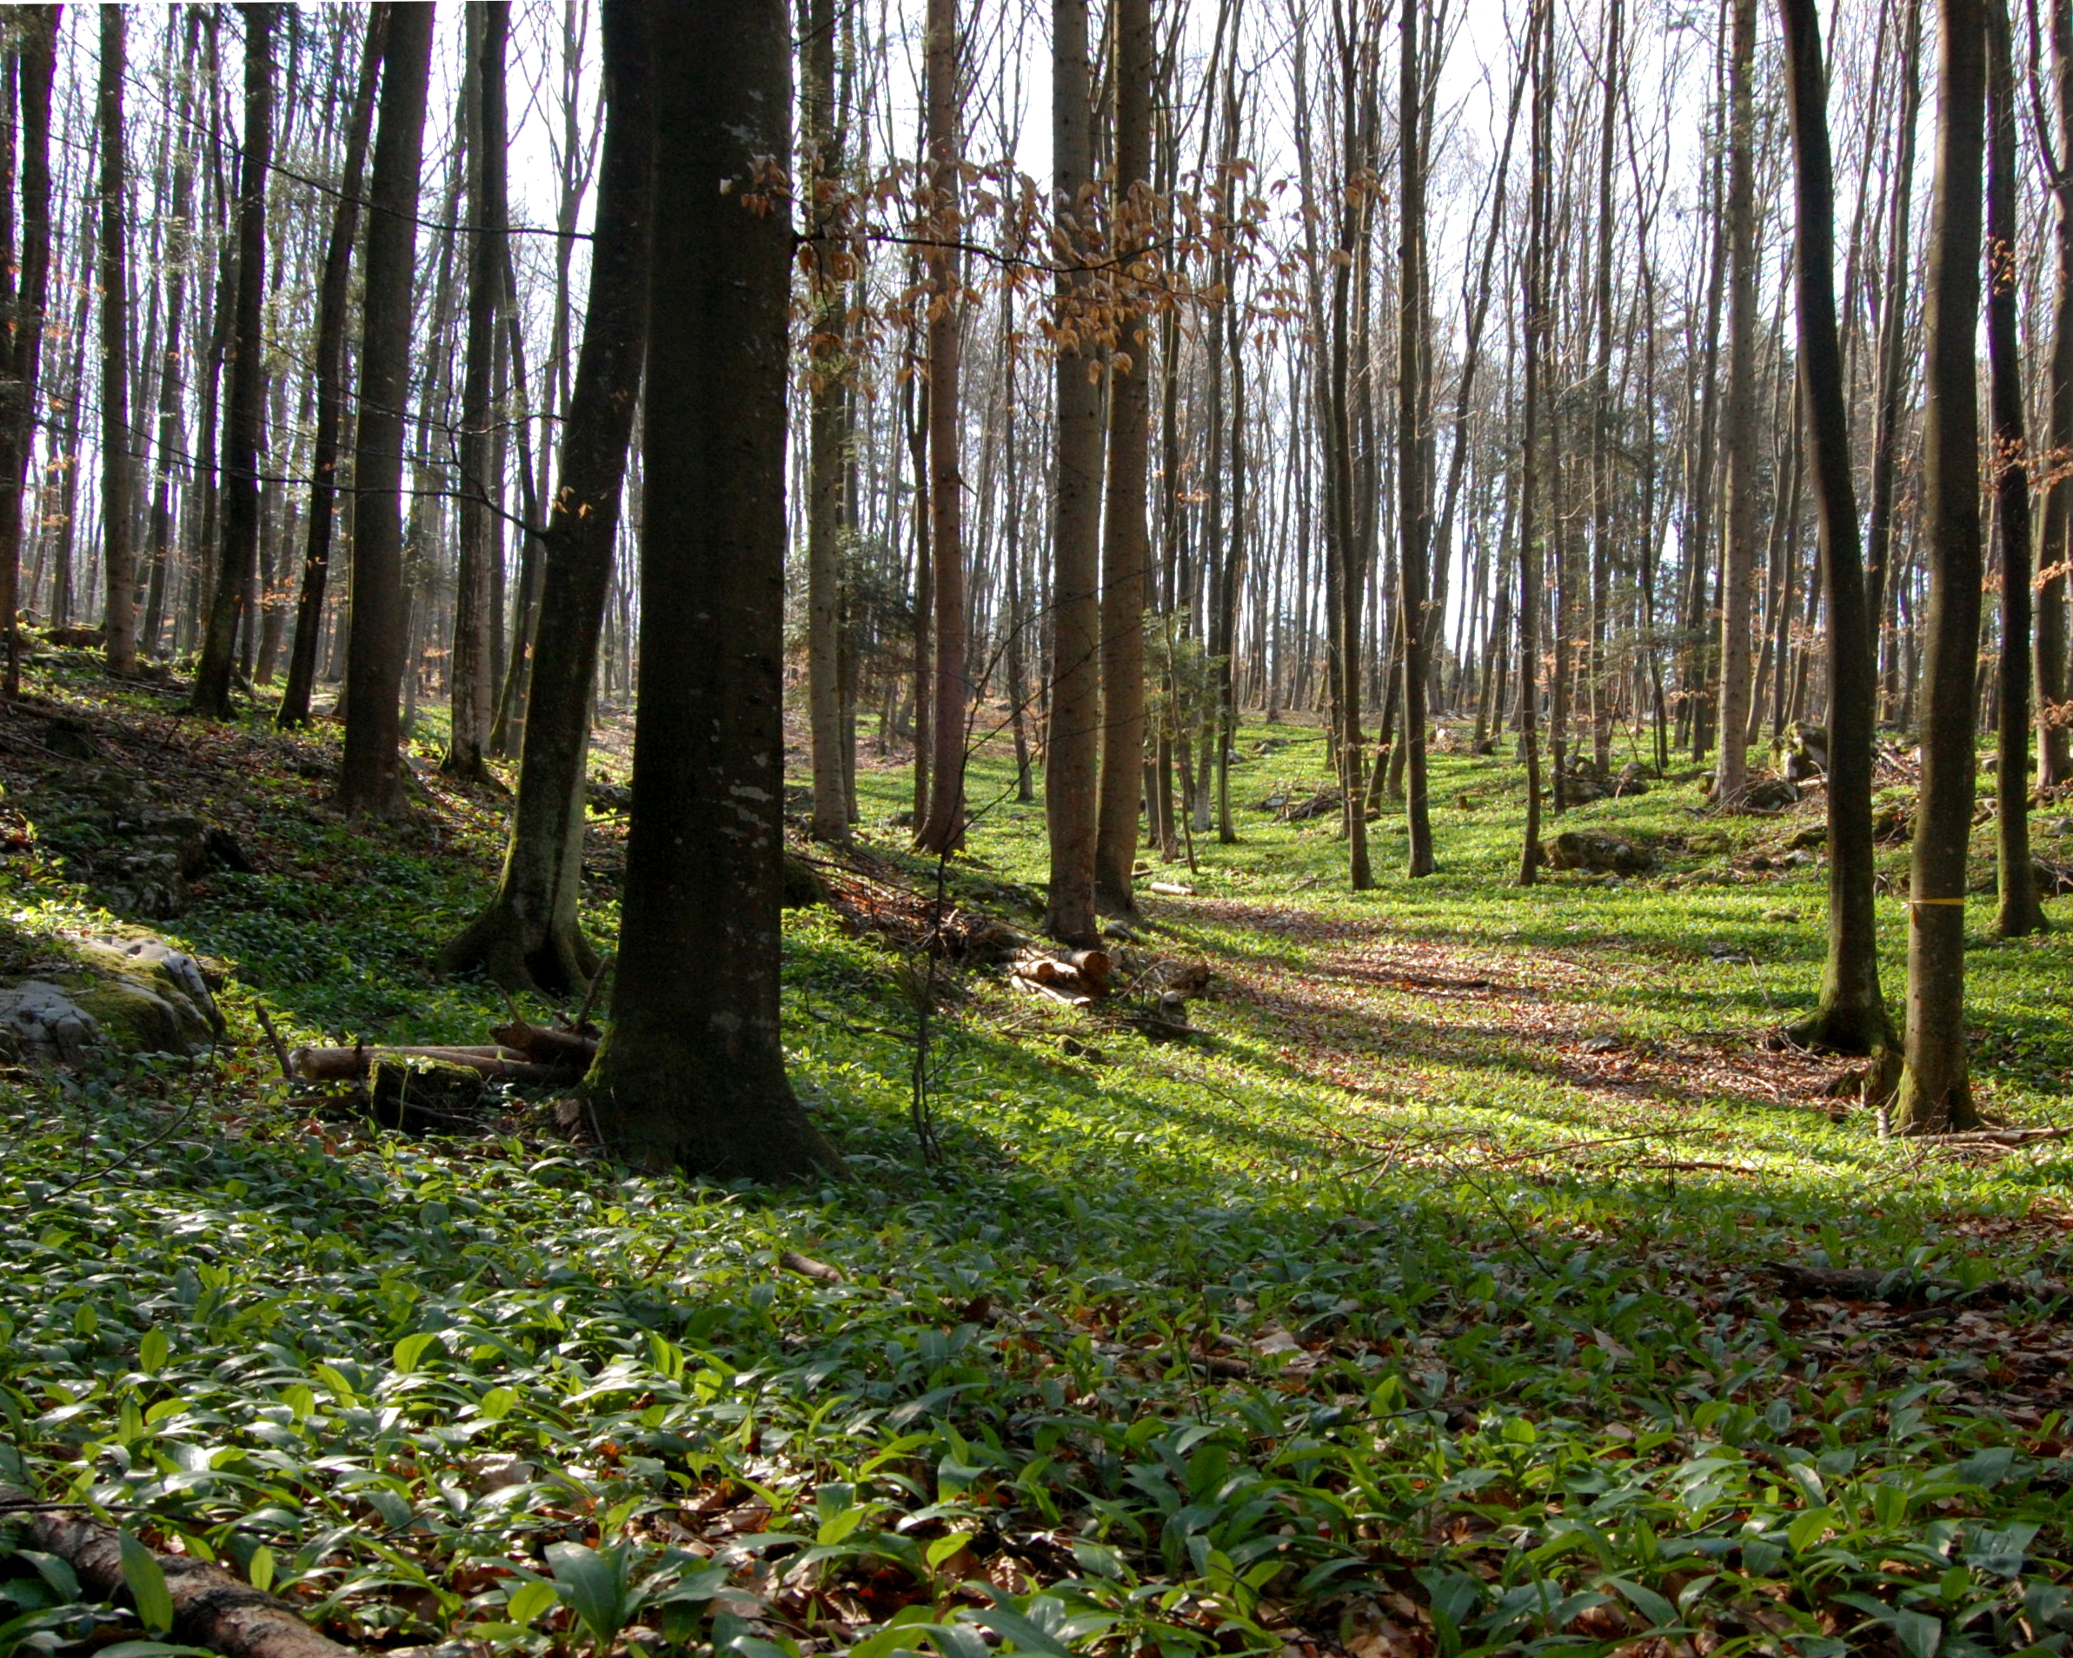
FORESTS:
Forests are vital ecosystems that provide oxygen, store carbon, and support biodiversity. They offer resources like wood, food, and medicine. Different types of forests, such as tropical, temperate, and boreal, exist based on climate and location. Human activities like deforestation threaten forests, making conservation and sustainable management crucial for the environment and climate stability.
This Photo by Unknown Author is licensed under CC BY-SA

Slide 4
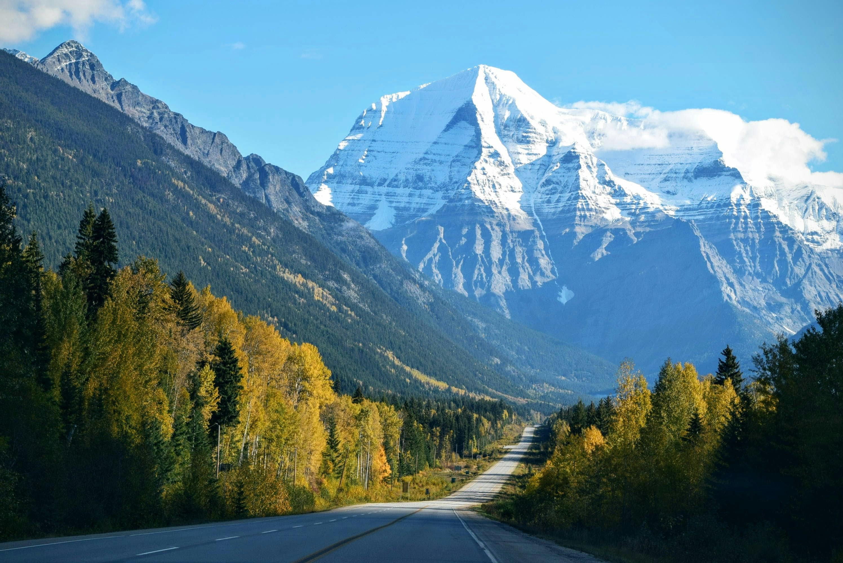
MOUNTAINS:
Mountains are elevated landforms formed by tectonic forces or volcanic activity. They regulate climate, water cycles, and provide habitats for diverse species. Mountains offer resources like minerals and water but face threats from climate change and human development.

Slide 5
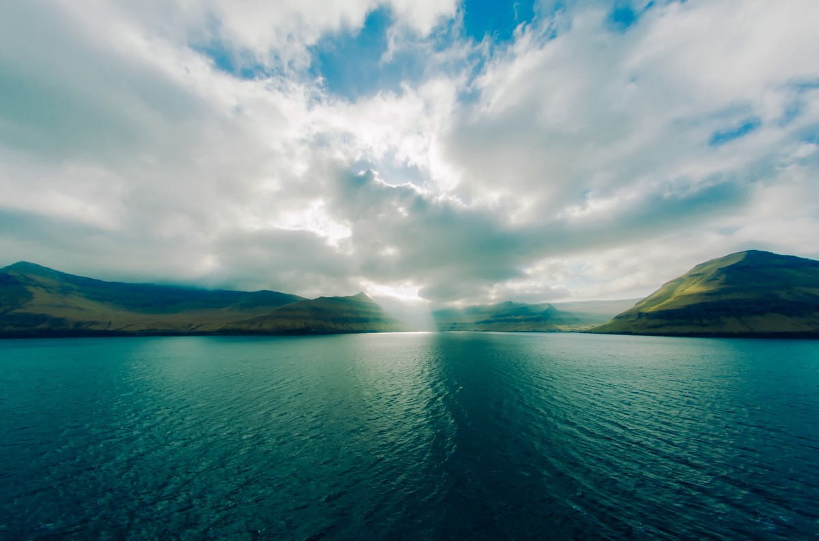
OCEANS:
Oceans are vast bodies of saltwater that cover over 70% of Earth's surface. They regulate climate, support marine life, and provide resources like food, oil, and minerals. Oceans play a key role in the water cycle and are vital for global trade, but they face threats from pollution, overfishing, and climate change.

Slide 6
CONNECTION :
Aspect | Forest | Ocean | Mountain
Role in Climate | Absorb carbon, regulate temperature, oxygen production | Regulate global temperature, carbon storage | Affect weather patterns, influence climate
Biodiversity | Home to diverse species of plants and animals | Supports marine life, coral reefs, and ecosystems | Host various species adapted to harsh conditions
Water Cycle | Contribute to rainfall and water regulation | Evaporate water, influence rainfall patterns | Affect precipitation and water flow
Resources | Provide wood, food, medicine, and habitat | Offer food (fish), minerals, energy resources | Provide water sources, minerals, recreation
Environmental Threats | Deforestation, illegal logging, climate change | Pollution, overfishing, warming waters | Deforestation, mining, climate change
Connection to Nature | Crucial for ecosystem stability and health | Integral to the Earth's biosphere, life support | Influence local and global ecosystems

Slide 7
OCEAN
MOUNTAIN
FOREST
NATURE

Slide 8
THANK YOU
FOR
BEING WITH ME

